Slide 1
Chapter 17: Distributed Systems

Slide 2
Chapter 17: Distributed Systems
Advantages of Distributed Systems
Types of Network-Based Operating Systems
Network Structure
Communication Structure
Communication Protocols
An Example: TCP/IP
Robustness
Design Issues
Distributed File System

Slide 3
Chapter Objectives
To provide a high-level overview of distributed systems and the networks that interconnect them
To discuss the general structure of distributed operating systems
To explain general communication structure and communication protocols
To describe issues concerning the design of distributed systems

Slide 4

Advantages of Distributed Systems
Distributed system is collection of loosely coupled processors interconnected by a communications network
Processors variously called nodes, computers, machines, hosts
  Site is location of the processor
  Generally a server has a resource a client node at a different site wants to use

Slide 5
Advantages of Distributed Systems
Reasons for distributed systems
  Resource sharing
    Sharing and printing files at remote sites
    Processing information in a distributed database
    Using remote specialized hardware devices
  Computation speedup – load sharing or job migration
  Reliability – detect and recover from site failure, function transfer, reintegrate failed site
  Communication – message passing
    All higher-level functions of a standalone system can be expanded to encompass a distributed system
  Computers can be downsized, more flexibility, better user interfaces and easier maintenance by moving from large system to multiple smaller systems performing distributed computing

Slide 6
Types of Distributed Operating Systems
Network Operating Systems
Distributed Operating Systems

Slide 7
Network-Operating Systems
Users are aware of multiplicity of machines
Access to resources of various machines is done explicitly by:
  Remote logging into the appropriate remote machine (telnet, ssh)
  Remote Desktop (Microsoft Windows)
  Transferring data from remote machines to local machines, via the File Transfer Protocol (FTP) mechanism
Users must change paradigms – establish a session, give network-based commands
  More difficult for users

Slide 8
Distributed-Operating Systems
Users not aware of multiplicity of machines
  Access to remote resources similar to access to local resources
Data Migration – transfer data by transferring entire file, or transferring only those portions of the file necessary for the immediate task
Computation Migration – transfer the computation, rather than the data, across the system
  Via remote procedure calls (RPCs)
  or via messaging system

Slide 9
Distributed-Operating Systems (Cont.)
Process Migration – execute an entire process, or parts of it, at different sites
  Load balancing – distribute processes across network to even the workload
  Computation speedup – subprocesses can run concurrently on different sites
  Hardware preference – process execution may require specialized processor
  Software preference – required software may be available at only a particular site
  Data access – run process remotely, rather than transfer all data locally
Consider the World Wide Web

Slide 10
Network Structure
Local-Area Network (LAN) – designed to cover small geographical area
  Multiple topologies like star or ring
  Speeds from 1Mb per second (Appletalk, bluetooth) to 40 Gbps for fastest Ethernet over twisted pair copper or optical fibre
  Consists of multiple computers (mainframes through mobile devices), peripherals (printers, storage arrays), routers (specialized network communication processors) providing access to other networks
  Ethernet most common way to construct LANs
    Multiaccess bus-based
    Defined by standard IEEE 802.3
  Wireless spectrum (WiFi) increasingly used for networking
    I.e. IEEE 802.11g standard implemented at 54 Mbps

Slide 11
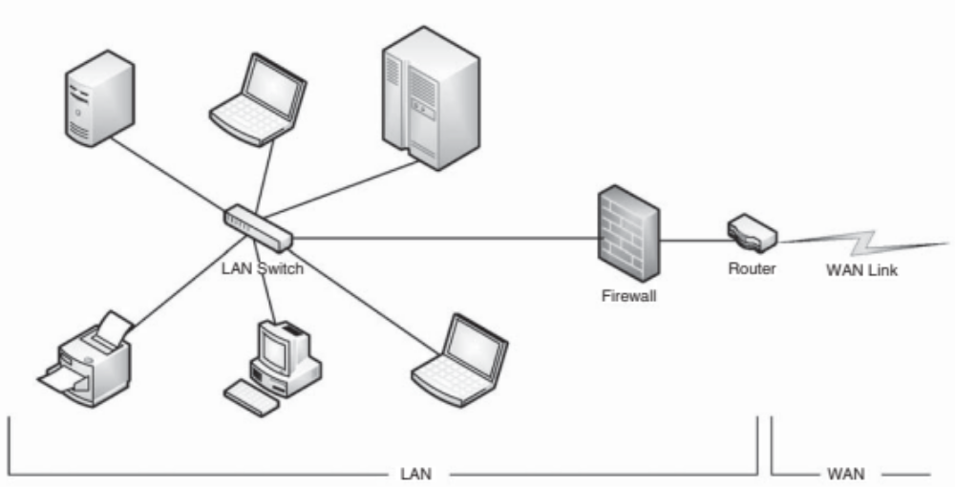
Local-area Network

Slide 12
Network Types (Cont.)
Wide-Area Network (WAN) – links geographically separated sites
  Point-to-point connections over long-haul lines (often leased from a phone company)
    Implemented via connection processors known as routers
  Internet WAN enables hosts world wide to communicate
    Hosts differ in all dimensions but WAN allows communications
  Speeds
    T1 link is 1.544 Megabits per second
    T3 is 28 x T1s = 45 Mbps
    OC-12 is 622 Mbps
  WANs and LANs interconnect, similar to cell phone network:
    Cell phones use radio waves to cell towers
    Towers connect to other towers and hubs

Slide 13
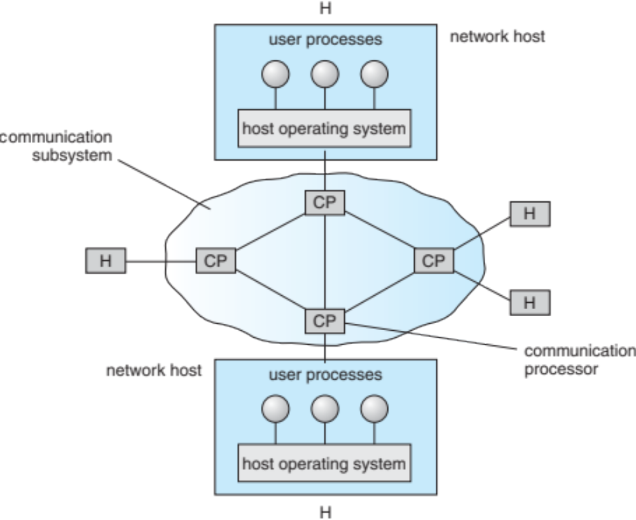
Communication Processors in a
Wide-Area Network

Slide 14
Communication Structure
The design of a communication network must address four basic issues:
Naming and name resolution - How do two processes locate each other to communicate?
Routing strategies - How are messages sent through the network?
Connection strategies - How do two processes send a sequence of messages?
Contention - The network is a shared resource, so how do we resolve conflicting demands for its use?

Slide 15
Naming and Name Resolution
Name systems in the network
Address messages with the process-id
Identify processes on remote systems by
      <host-name, identifier> pair
Domain name system (DNS) – specifies the naming structure of the hosts, as well as name to address resolution (Internet)

Slide 16
Routing Strategies
Fixed routing - A path from A to B is specified in advance; path changes only if a hardware failure disables it
  Since the shortest path is usually chosen, communication costs are minimized
  Fixed routing cannot adapt to load changes
  Ensures that messages will be delivered in the order in which they were sent
Virtual routing- A path from A to B is fixed for the duration of one session. Different sessions involving messages from A to B may have different paths
  Partial remedy to adapting to load changes
  Ensures that messages will be delivered in the order in which they were sent

Slide 17
Routing Strategies (Cont.)
Dynamic routing - The path used to send a message form site A to site B is chosen only when a message is sent
  Usually a site sends a message to another site on the link least used at that particular time
  Adapts to load changes by avoiding routing messages on heavily used path
  Messages may arrive out of order
    This problem can be remedied by appending a sequence number to each message
  Most complex to set up
Tradeoffs mean all methods are used
  UNIX provides ability to mix fixed and dynamic
  Hosts may have fixed routes and gateways connecting networks together may have dynamic routes

Slide 18
Routing Strategies (Cont.)
Router is communications processor responsible for routing messages
Must have at least 2 network connections
Maybe special purpose or just function running on host
Checks its tables to determine where destination host is, where to send messages
  Static routing – table only changed manually
  Dynamic routing – table changed via routing protocol
More recently, routing managed by intelligent software more intelligently than routing protocols
  OpenFlow is device-independent, allowing developers to introduce network efficiencies by decoupling data-routing decisions from underlying network devices
Messages vary in length – simplified design breaks them into packets (or frames, or datagrams)
Connectionless message is just one packet
  Otherwise need a connection to get a multi-packet message from source to destination

Slide 19
Connection Strategies
Circuit switching - A permanent physical link is established for the duration of the communication (i.e., telephone system)
Message switching - A temporary link is established for the duration of one message transfer (i.e., post-office mailing system)
Packet switching - Messages of variable length are divided into fixed-length packets which are sent to the destination
  Each packet may take a different path through the network
  The packets must be reassembled into messages as they arrive
Circuit switching requires setup time, but incurs less overhead for shipping each message, and may waste network bandwidth
  Message and packet switching require less setup time, but incur more overhead per message

Slide 20
Communication Protocol
The communication network is partitioned into the following multiple layers:
Layer 1: Physical layer – handles the mechanical and electrical details of the physical transmission of a bit stream
Layer 2: Data-link layer – handles the frames, or fixed-length parts of packets, including any error detection and recovery that occurred in the physical layer
Layer 3: Network layer – provides connections and routes packets in the communication network, including handling the address of outgoing packets, decoding the address of incoming packets, and maintaining routing information for proper response to changing load levels

Slide 21
Communication Protocol (Cont.)
Layer 4: Transport layer – responsible for low-level network access and for message transfer between clients, including partitioning messages into packets, maintaining packet order, controlling flow, and generating physical addresses
Layer 5: Session layer – implements sessions, or process-to-process communications protocols
Layer 6: Presentation layer – resolves the differences in formats among the various sites in the network, including character conversions, and half duplex/full duplex (echoing)
Layer 7: Application layer – interacts directly with the users, deals with file transfer, remote-login protocols and electronic mail, as well as schemas for distributed databases

Slide 22
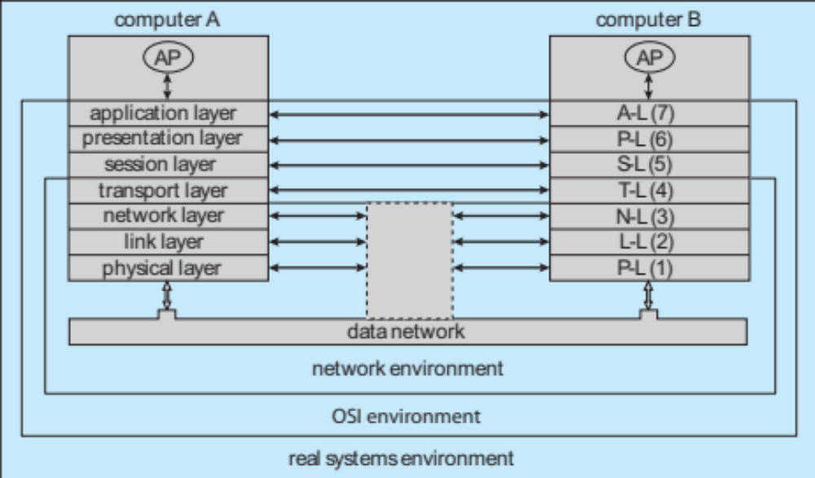
Communication Via ISO Network Model

Slide 23
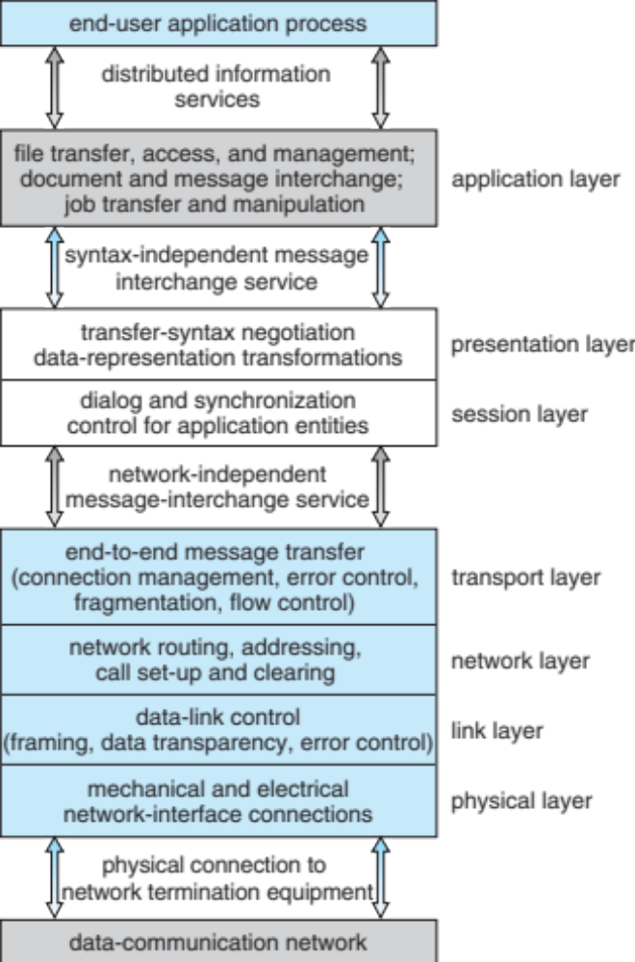
The ISO Protocol Layer

Slide 24
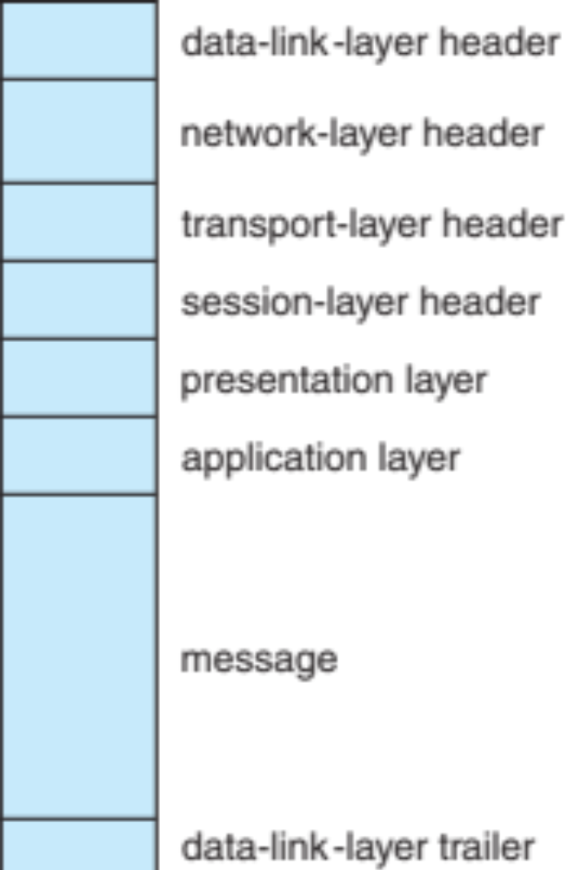
The ISO Network Message

Slide 25
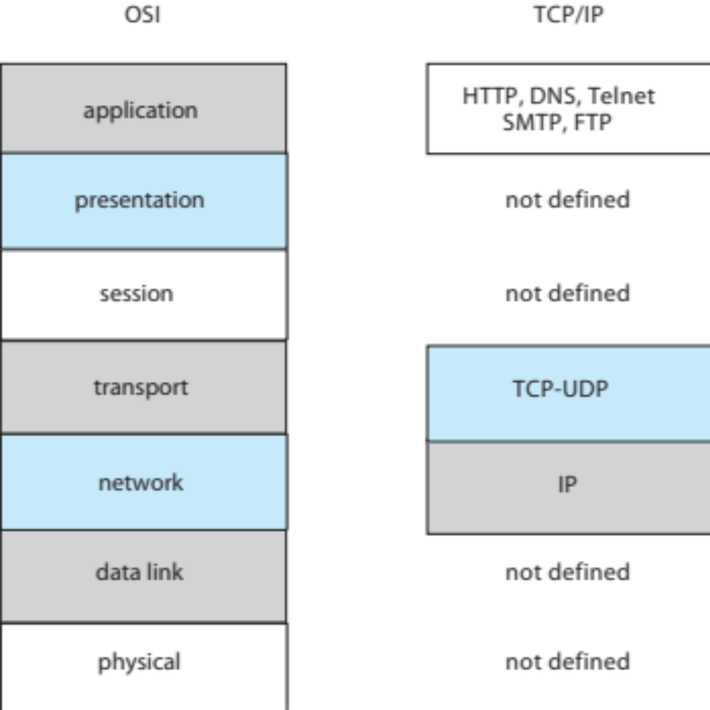
The TCP/IP Protocol Layers

Slide 26
Example: TCP/IP
The transmission of a network packet between hosts on an Ethernet network
Every host has a unique IP address and a corresponding Ethernet Media Access Control (MAC) address
Communication requires both addresses
Domain Name Service (DNS) can be used to acquire IP addresses
Address Resolution Protocol (ARP) is used to map MAC addresses to IP addresses
  Broadcast to all other systems on the Ethernet network
If the hosts are on the same network, ARP can be used
  If the hosts are on different networks, the sending host will send the packet to a router which routes the packet to the destination network

Slide 27
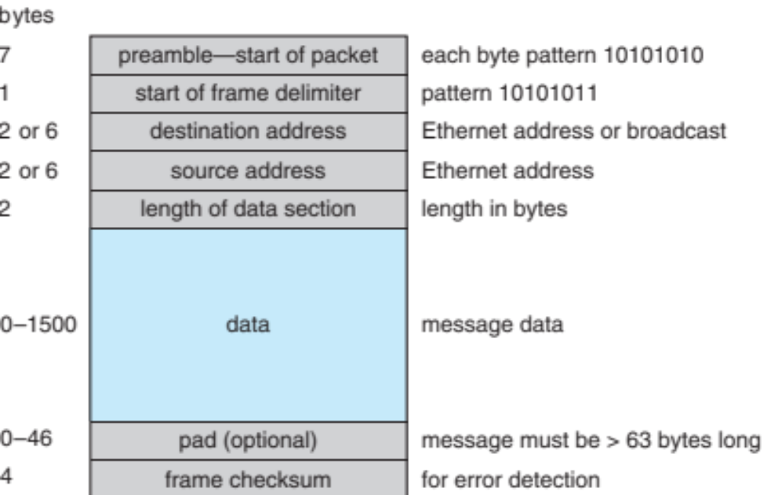
An Ethernet Packet

Slide 28
Robustness
Failure detection
Reconfiguration

Slide 29
Failure Detection
Detecting hardware failure is difficult
To detect a link failure, a heartbeat protocol can be used
Assume Site A and Site B have established a link
  At fixed intervals, each site will exchange an I-am-up message indicating that they are up and running
If Site A does not receive a message within the fixed interval, it assumes either (a) the other site is not up or (b) the message was lost
Site A can now send an Are-you-up? message to Site B
If Site A does not receive a reply, it can repeat the message or try an alternate route to Site B

Slide 30
Failure Detection (Cont.)
If Site A does not ultimately receive a reply from Site B, it concludes some type of failure has occurred
Types of failures:
- Site B is down
- The direct link between A and B is down
- The alternate link from A to B is down
- The message has been lost
However, Site A cannot determine exactly why the failure has occurred

Slide 31
Reconfiguration
When Site A determines a failure has occurred, it must reconfigure the system:
1. If the link from A to B has failed, this must be broadcast to every site in the system
2. If a site has failed, every other site must also be notified indicating that the services offered by the failed site are no longer available
When the link or the site becomes available again, this information must again be broadcast to all other sites

Slide 32
Design Issues
Transparency – the distributed system should appear as a conventional, centralized system to the user
Fault tolerance – the distributed system should continue to function in the face of failure
Scalability – as demands increase, the system should easily accept the addition of new resources to accommodate the increased demand
  Consider Hadoop open source programming framework for processing large datasets in distributed environments (based on Google search indexing)
Clusters – a collection of semi-autonomous machines that acts as a single system

Slide 33
Distributed File System
Distributed file system (DFS) – a distributed implementation of the classical time-sharing model of a file system, where multiple users share files and storage resources
A DFS manages set of dispersed storage devices
Overall storage space managed by a DFS is composed of different, remotely located, smaller storage spaces
There is usually a correspondence between constituent storage spaces and sets of files
Challenges include:
  Naming and Transparency
  Remote File Access

Slide 34
DFS Structure
Service – software entity running on one or more machines and providing a particular type of function to a priori unknown clients
Server – service software running on a single machine
Client – process that can invoke a service using a set of operations that forms its client interface
A client interface for a file service is formed by a set of primitive file operations (create, delete, read, write)
Client interface of a DFS should be transparent, i.e., not distinguish between local and remote files
Sometimes lower level intermachine interface need for cross-machine interaction

Slide 35
Naming and Transparency
Naming – mapping between logical and physical objects
Multilevel mapping – abstraction of a file that hides the details of how and where on the disk the file is actually stored
A transparent DFS hides the location where in the network the file is stored
For a file being replicated in several sites, the mapping returns a set of the locations of this file’s replicas; both the existence of multiple copies and their location are hidden

Slide 36
Naming Structures
Location transparency – file name does not reveal the file’s physical storage location
Location independence – file name does not need to be changed when the file’s physical storage location changes

Slide 37
Naming Schemes — Three Main Approaches
Files named by combination of their host name and local name; guarantees a unique system-wide name
Attach remote directories to local directories, giving the appearance of a coherent directory tree; only previously mounted remote directories can be accessed transparently
Total integration of the component file systems
  A single global name structure spans all the files in the system
  If a server is unavailable, some arbitrary set of directories on different machines also becomes unavailable
In practice most DFSs use static, location-transparent mapping for user-level names
  Some support file migration
  Hadoop supports file migration but without following POSIX standards

Slide 38
Remote File Access
Remote-service mechanism is one transfer approach
Reduce network traffic by retaining recently accessed disk blocks in a cache, so that repeated accesses to the same information can be handled locally
  If needed data not already cached, a copy of data is brought from the server to the user
  Accesses are performed on the cached copy
  Files identified with one master copy residing at the server machine, but copies of (parts of) the file are scattered in different caches
  Cache-consistency problem – keeping the cached copies consistent with the master file
    Could be called network virtual memory

Slide 39
Cache Location – Disk vs. Main Memory
Advantages of disk caches
  More reliable
  Cached data kept on disk are still there during recovery and don’t need to be fetched again
Advantages of main-memory caches:
  Permit workstations to be diskless
  Data can be accessed more quickly
  Performance speedup in bigger memories
  Server caches (used to speed up disk I/O) are in main memory regardless of where user caches are located; using main-memory caches on the user machine permits a single caching mechanism for servers and users

Slide 40
Cache Update Policy
Write-through – write data through to disk as soon as they are placed on any cache
  Reliable, but poor performance
Delayed-write (write-back) – modifications written to the cache and then written through to the server later
  Write accesses complete quickly; some data may be overwritten before they are written back, and so need never be written at all
  Poor reliability; unwritten data will be lost whenever a user machine crashes
  Variation – scan cache at regular intervals and flush blocks that have been modified since the last scan
  Variation – write-on-close, writes data back to the server when the file is closed
    Best for files that are open for long periods and frequently modified

Slide 41
Consistency
Is locally cached copy of the data consistent with the master copy?
Client-initiated approach
  Client initiates a validity check
  Server checks whether the local data are consistent with the master copy
Server-initiated approach
  Server records, for each client, the (parts of) files it caches
  When server detects a potential inconsistency, it must react

Slide 42
End of Chapter 17

